Slide 1
FitBit Case Study
Group 1 Project 1

Slide 2
The team
Luke O’Malley
Kelly Giron
Jennifer Harris
Jarvis Cathey
Robyn Pearson

Slide 3
Executive Summary
Project Overview
We chose to analyze this fitbit dataset to gain insight into other users' workout habits such as time of day with most activity logged, most calories burned, highest intensity levels, and whether there were any noticeable patterns.
FitBit case study data specs
Sample size: 33 participants
Date Range: April 11, 2016 to May 11, 2016
Data contains intensity, calories and time of day
Source: https://www.kaggle.com/datasets/srdavis16/fitbit-casestudy?select=CaloriesIntensityUpload2.csv
Notes:
An overview of the data collection, cleanup, and exploration processes: We chose this FitBit dataset from Kaggle because we all have a baseline interest in fitness and were curious to know when other users typically workout, and whether there were any noticeable patterns that might influence the way we incorporate fitness/activity into our own lifestyles. The dataset has data collected from 33 unique users over a one month period and the results are fairly straightforward, so we didn't have to do too much cleaning of the data. We did convert the "Time" column into an hour of the day format to ensure the visualizations were cleaner.

Slide 4
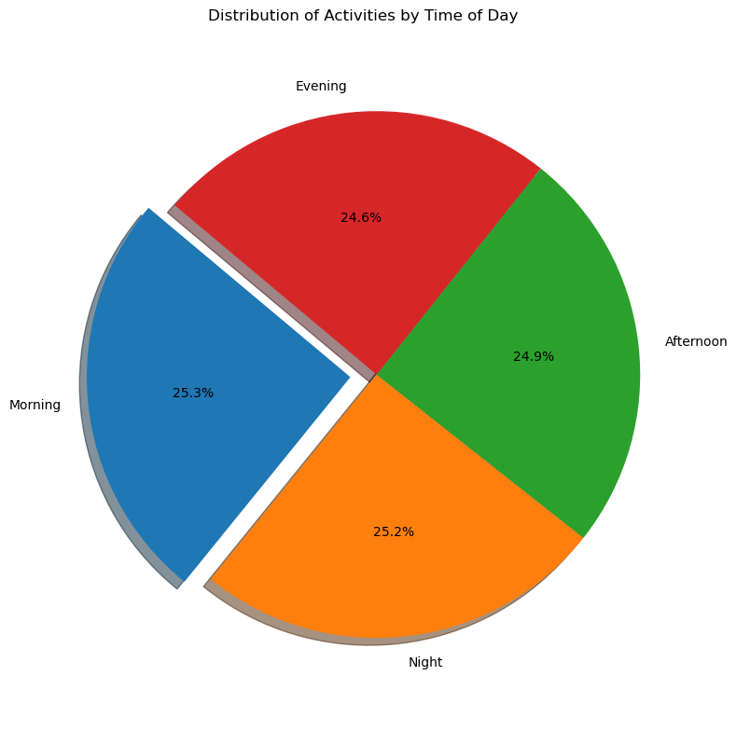
Distribution of Activities by time of day
The distribution of activities was spread evenly across all times of day.
We were surprised to see there was an even distribution. It could simply be that participants wore their fitbits at all times, including during sleep.
Notes:
Morning: 5am-10:59am. Afternoon: 11am-4:59pm. Evening: 5pm-11:59pm. Night: 12am-4:59am

Slide 5
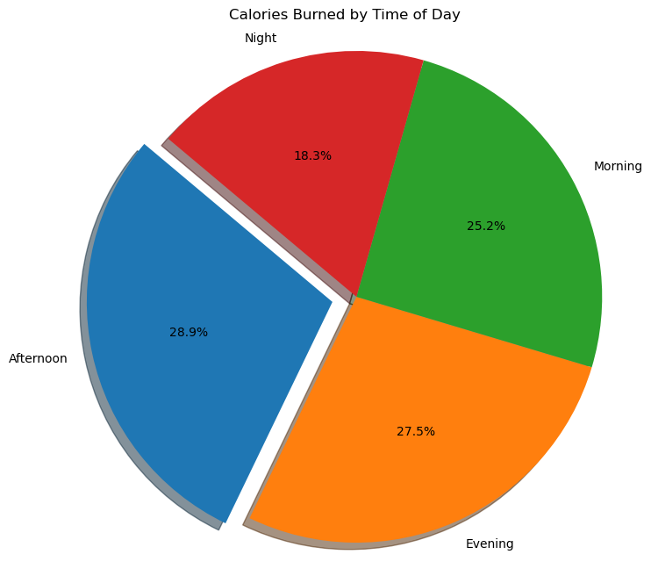
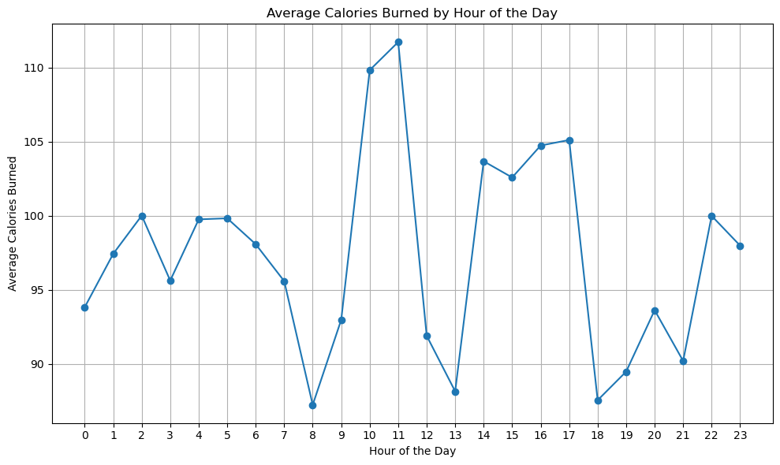
Calories burned by time of day
Most calories burned between 10am - 11am as well as 2pm - 5pm
Least amount of calories burned between 8am - 9am, 12pm - 1pm, and 6pm-7pm
Source: https://www.kaggle.com/datasets/srdavis16/fitbit-casestudy?select=CaloriesIntensityUpload2.csv
Notes:
Morning: 5am-10:59am. Afternoon: 11am-4:59pm. Evening: 5pm-11:59pm. Night: 12am-4:59am

Slide 6
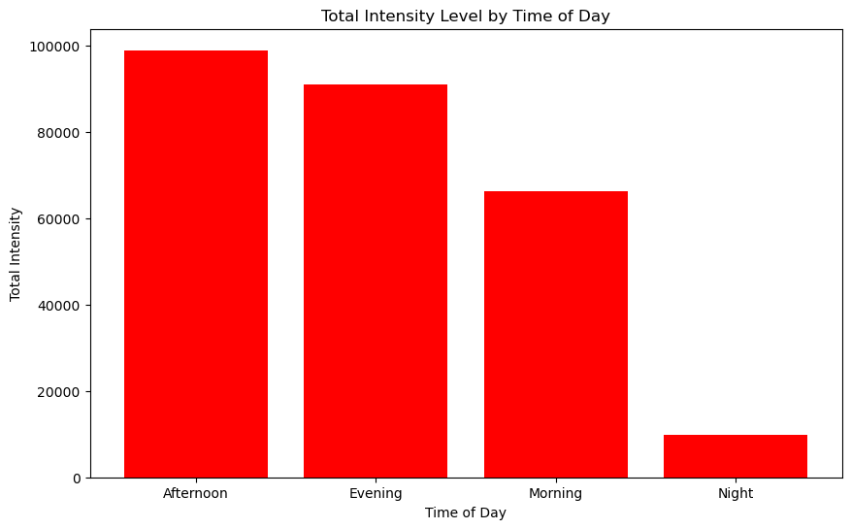
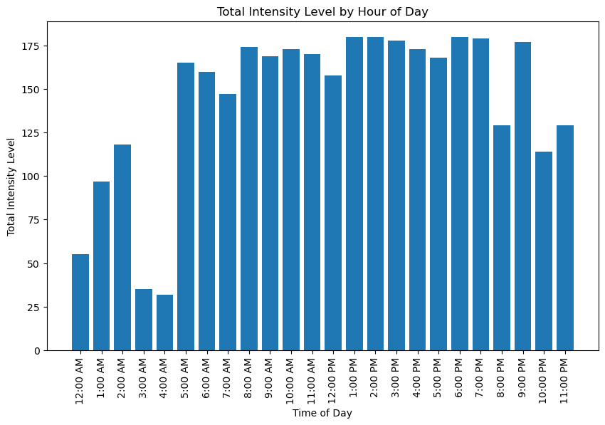
Intensity Level by Time of Day
Intensity level of exercises does not fluctuate much during core hours of the day when most activity is taking place between 5am and 9pm
Intensity levels drop off significantly at night time when people are typically sleeping
Source: https://www.kaggle.com/datasets/srdavis16/fitbit-casestudy?select=CaloriesIntensityUpload2.csv
Notes:
Morning: 5am-10:59am. Afternoon: 11am-4:59pm. Evening: 5pm-11:59pm. Night: 12am-4:59am

Slide 7
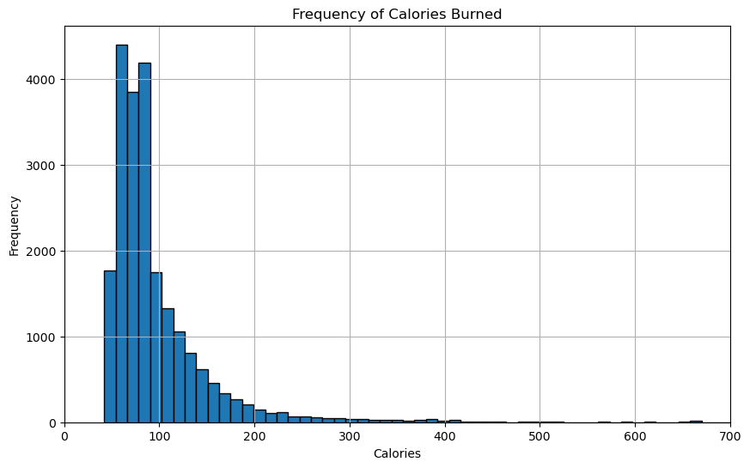
Frequency of calories burned per session
The majority of sessions burned between 50 - 100 calories

Slide 8
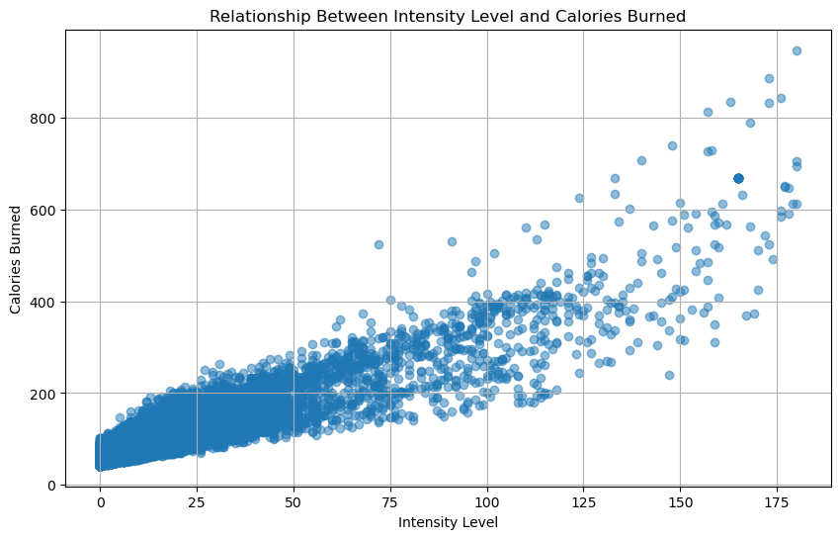
Intensity levels & Calories Burned
There is a correlation between intensity levels and calories burned, however, there are a number of variables that we do not know like duration, type of activity, etc.
Notes:
Variables that we don’t know: duration, type of activity logged, gender, fitness level and geographic regions

Slide 9
Next Steps
Expand timing
Expand sample size
Type of Exercises
Collect data over a longer period of time to analyze seasonality
Collect data with larger sample size
Collect data that includes type of exercise

Slide 10
Key Takeaways
As expected higher intensity levels typically result in more calories burned
Activity levels decreased at night when people are usually sleeping
Most active hours of the day are between 10am and 5pm

